Slide 1
Terminal App
Guess Number

Slide 2
It is a game.
Computer generated a number.
You try to guess the computer generated number.
Computer generate number from 1000 to 9999 but all numbers must be different.
Number can not be 1000, 1222 ,1244,9999 etc..
Number can not start with 0.

Slide 3
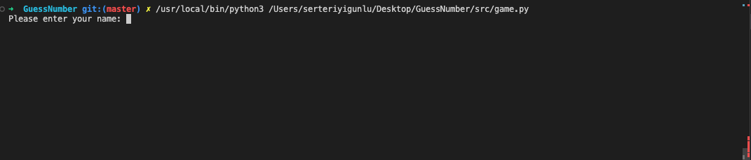
First ask your name

Slide 4
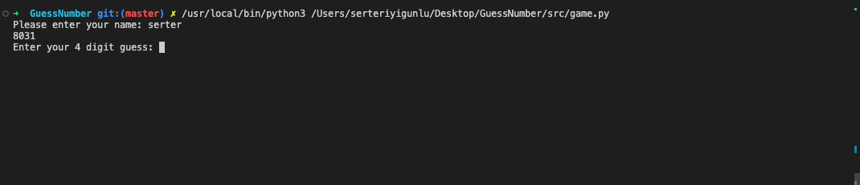
For demonstration purposes ,the generated number was shown.
Ask for your guess.
If you enter string,give you an error.

Slide 5
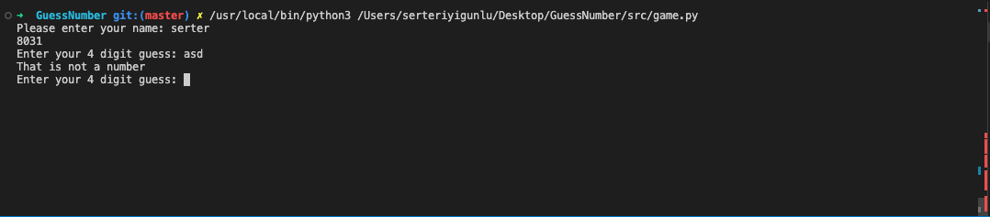

Slide 6
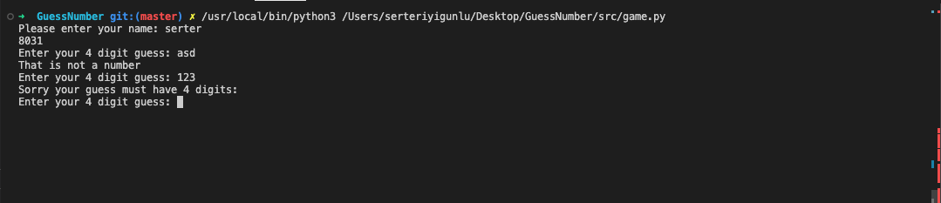
If enter less than 4 digits ,it gives an error.

Slide 7
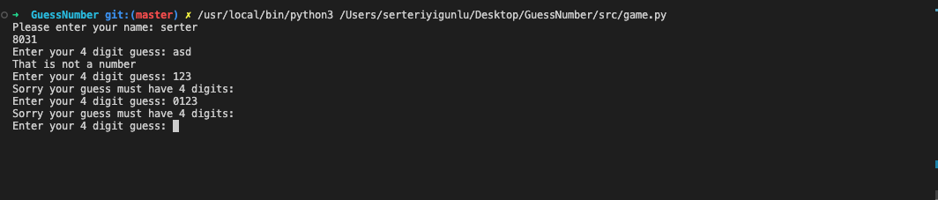
If first digit is 0 , it is defined as less than 4 digits number

Slide 8
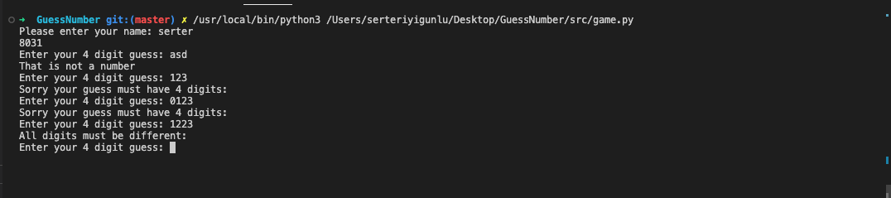
If there is a repeating number ,it gives an error.

Slide 9
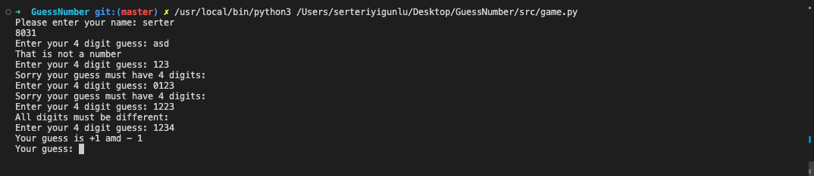
When all required items passed, guessing part begins.

Slide 10
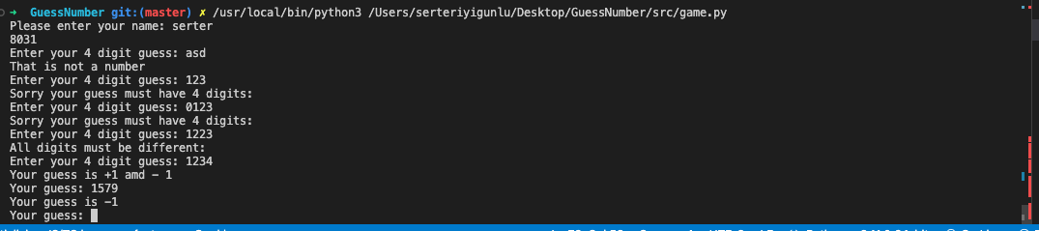

Slide 11
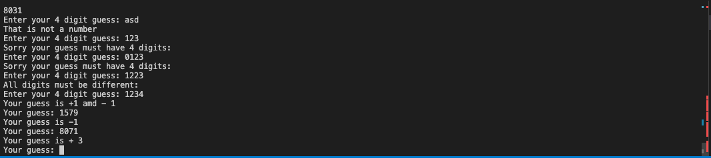

Slide 12
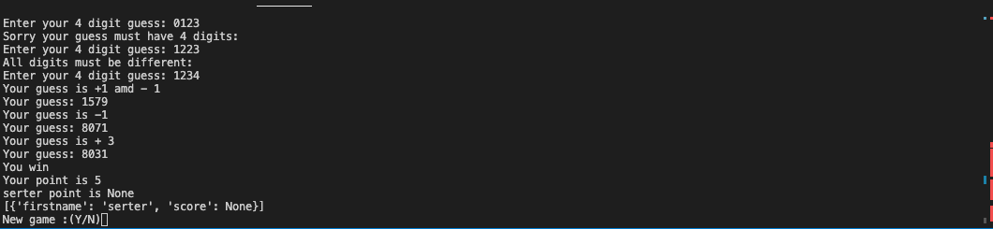
When you guessed the number,it asks you for a new game. Display your name and your point.

Slide 13
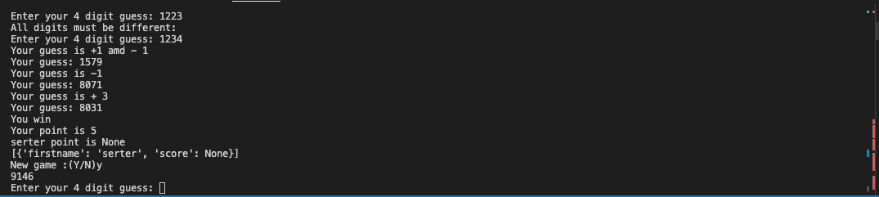
When you enter yes, game starts again.

Slide 14
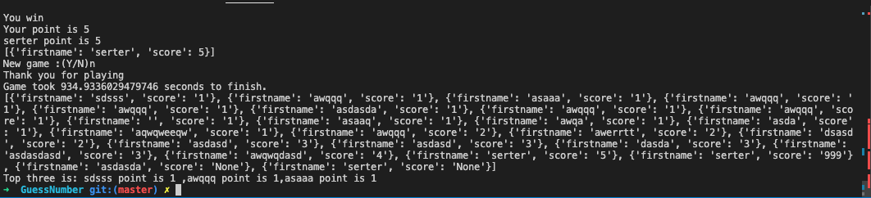
When you write n, game ends and display tnaks for playing and game time. And also top three players... List item shows there for demostration purposes.

Slide 15
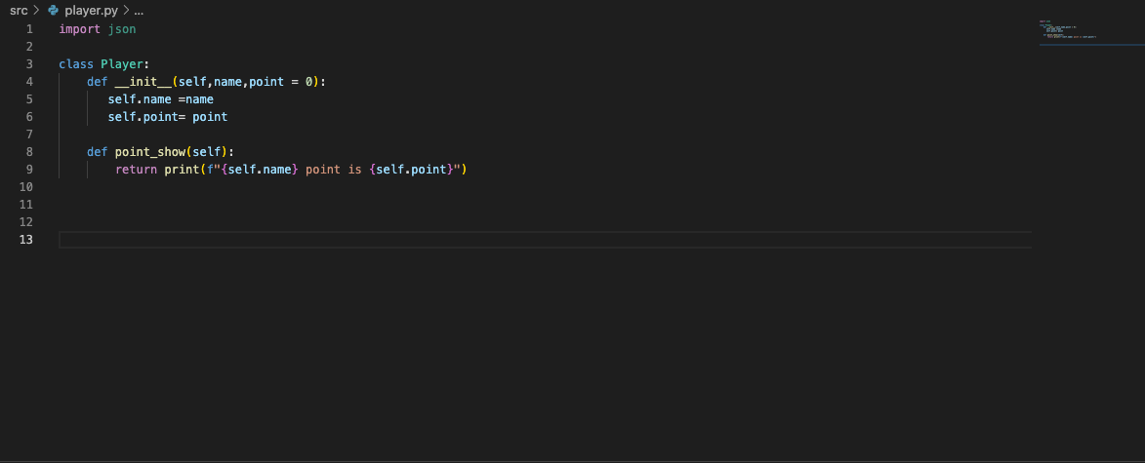
Desing Process
First step: I developed class Player to store player names and scores. Initial score is 0.

Slide 16
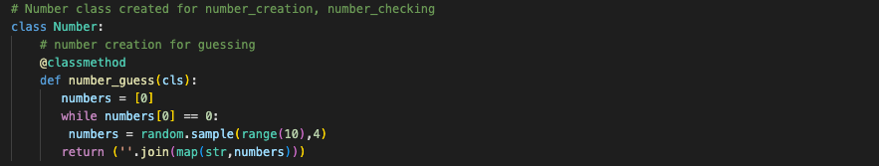
Second step: I created Number class to store all numbering functions.
In Number class ,I created first computer generates random number.

Slide 17
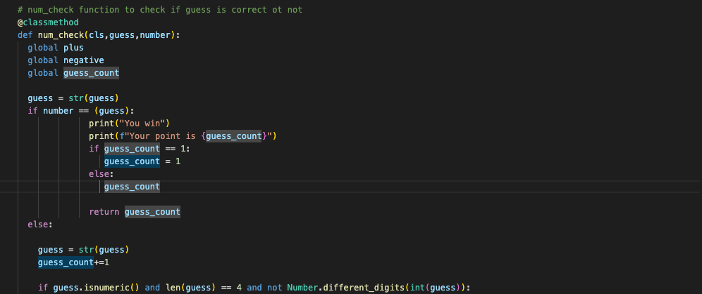
In Number Class I created main function for the game: Number checking.This is the last state for the function:

Slide 18
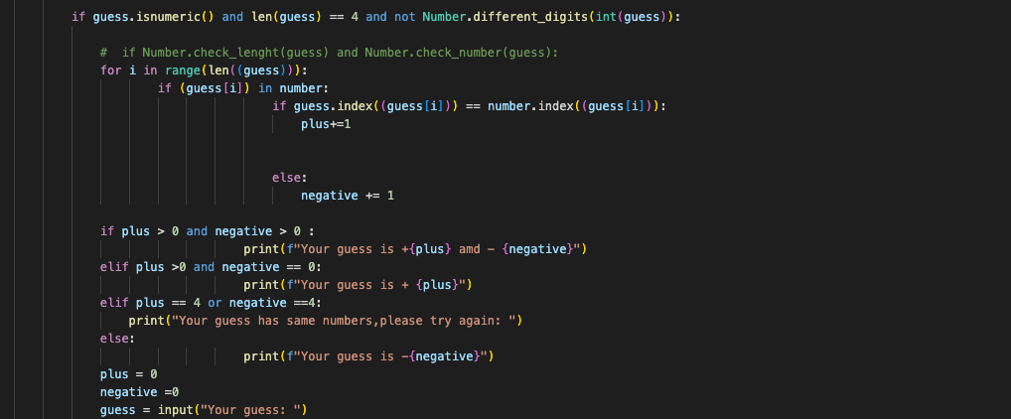

Slide 19
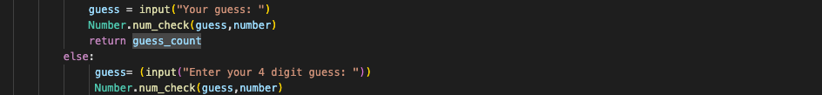

Slide 20
In this function,firstly check if guess equals the number,if so,print you win and then check if it is the first guess or not.If it is your first guess ,print your score,if not increase guess number 1 and print your score.
if your gues is not correct, firstly it checks if your guess is digit,length your guess and repating number.
If all passed,it starts comparing your guess with the number and display your guess opuput + and - expressions.
If not passed ,it asks you another guess and repearing the process again.

Slide 21
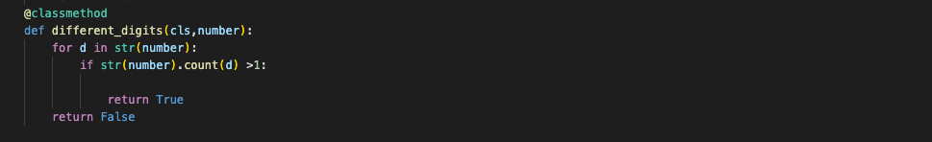
During the previous ste pdeveloping, I started to develop different digits function to check all digits are not same.The function is below:

Slide 22
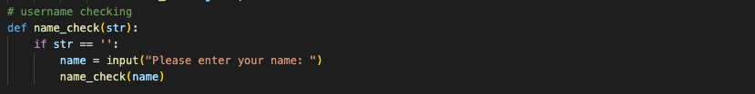
After creating functions above, I decided to check for username. If empty string is entered .it asking you for another name.The function is below:

Slide 23
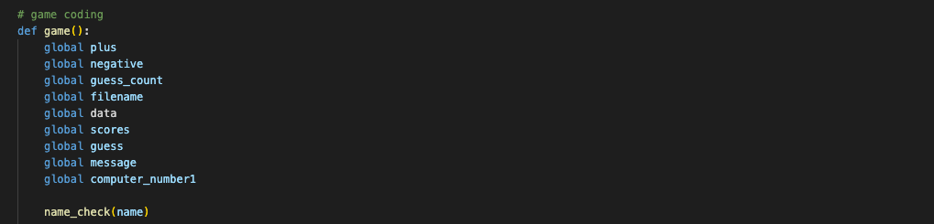
Game function creating.
Beginning of the game function ,I check if the name entered is the correct format.

Slide 24
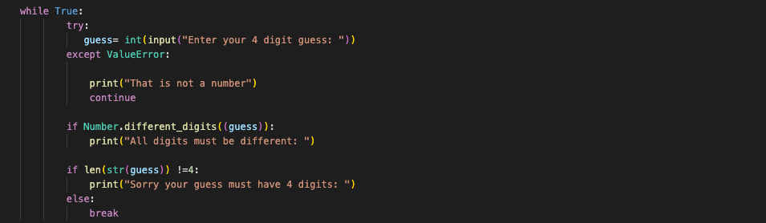
After name checking, I creating try-except block to handle errors.Code as follows:

Slide 25
After this point, I creating count variable and it equeals to a function in Number class num_check.It is the main function to compare guess with the number.

Slide 26
After count variable returns, player point is updated. And Display point with the player name.Code as follows:

Slide 27
After this step,Json file and csv file is updated.The code is follow.It calls the functions.I develop this functions as well .I added screedshots for the functions below.

Slide 28
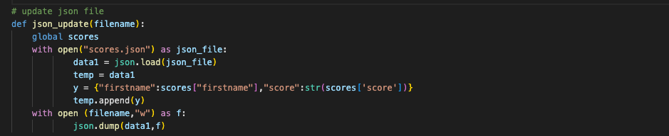
Json update function:

Slide 29
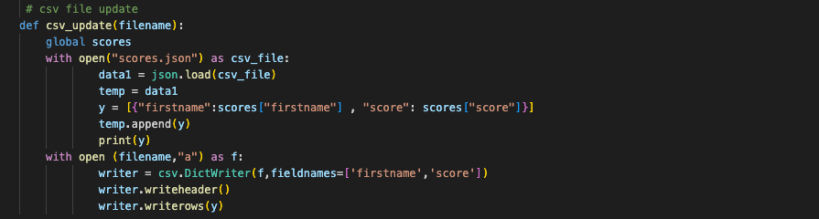
Csv Update function:

Slide 30
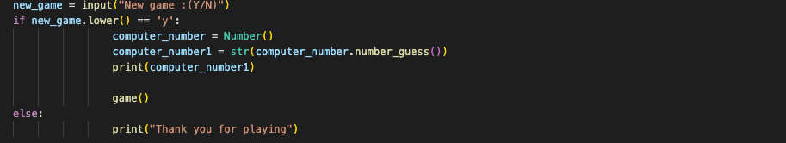
After this steps,new_game variable creating with input New game:Y/N
If yes, game start again
If no,printThanks for playing

Slide 31
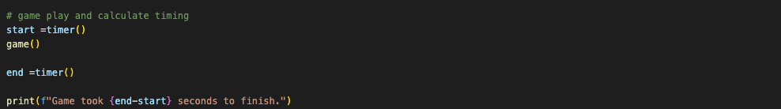
Timer function is working to calculate how long took for the game.

Slide 32
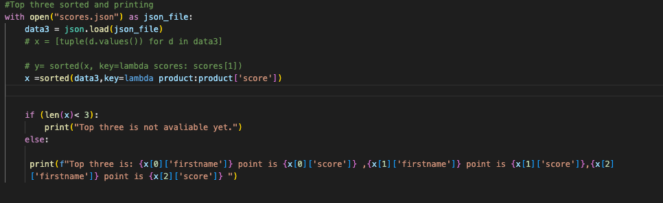
The last one is display top three players.

Slide 33
The problems that I did face during the game development:
1. Generate random four digits number. It is easy to generate 4 digits number but what I try to do each digits must be different and number not start with 0. To do that ,I used a function called number_guess in the Number class.First i cretaed a list called numbers with a member of only 0. First digit can not be 0 so I used while loop to check first digit.random.sample() function generate random number. random.sample(sequence,k).Sequence can be list,tuple,string or set. In this example random.sample(range(10),4) is a sequence numbers. K is an integer number, and it shows length of sampe.In this case k = 4.

Slide 34
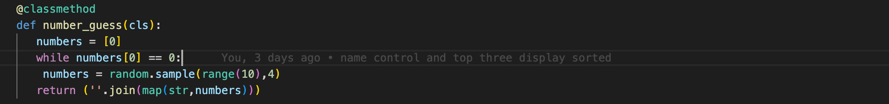

Slide 35
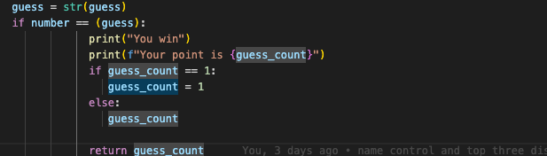
2.Create a num_check function. Basically it checks the user input with computer number and display output. I used two main argumant.First one if guess == computer number. In this case I need to check two importan things. First one is guess count number,it increases every wrong guess. It is the first guess or not. I used if statement for that.

Slide 36
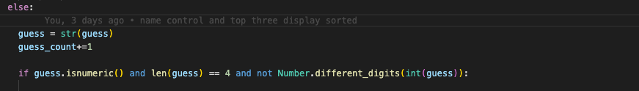
If it is not the first guess, I used else statment to check the guess number with computer number. I need to put checking paramenter beginning of the codes if number entered is digit number, check length of the number and not have repeating number.

Slide 37
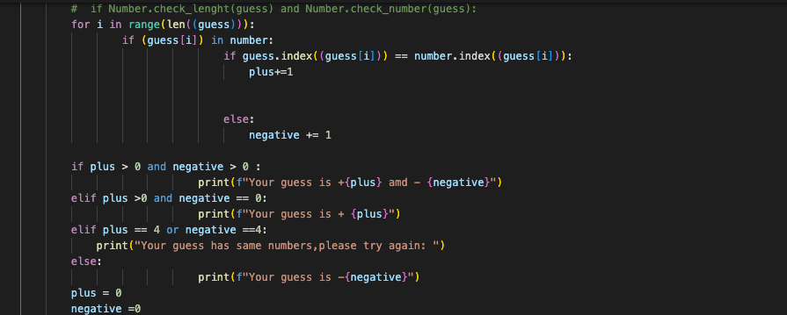
After this check, program will check the user guess and computer number.

Slide 38
if it is not a valid number,it will give an error.

Slide 39
3. Json file update:
It was kind of difficult to update json file. I could not find a way to initialize the json file from stractch. So I used in the seperate json file with inital value. I enter my name Serter as first name argument and my score, I entered 999 bigger number.My code as follows:

Slide 41
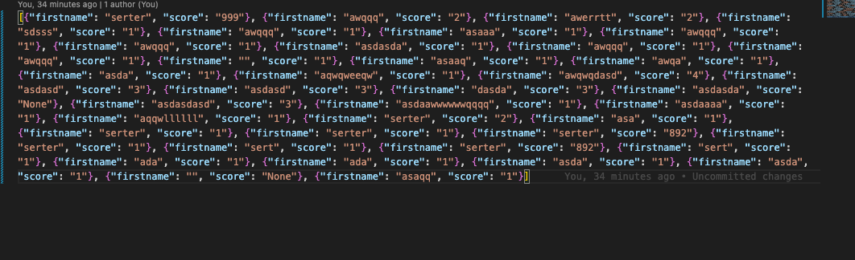
Json File

Slide 42
4. Try.except code: First check was easy .It was a check if number is digit or not. I wanted to check if number guess length is 4 or not and also check if the number has repeating digits.
I used for those ones, else statements as follows:

Slide 44
4. The last issue is to display top three players. I need to sort the json file with the lowest points.
The json file is read first, and using lambda key word it is sorted with the lowest points.
Printing the lowest three points.

Slide 46
Testing
All test performed manually.
Num_check function, player name checking,try/except checking,json update file function checking and display top three players function checking done.

Slide 47
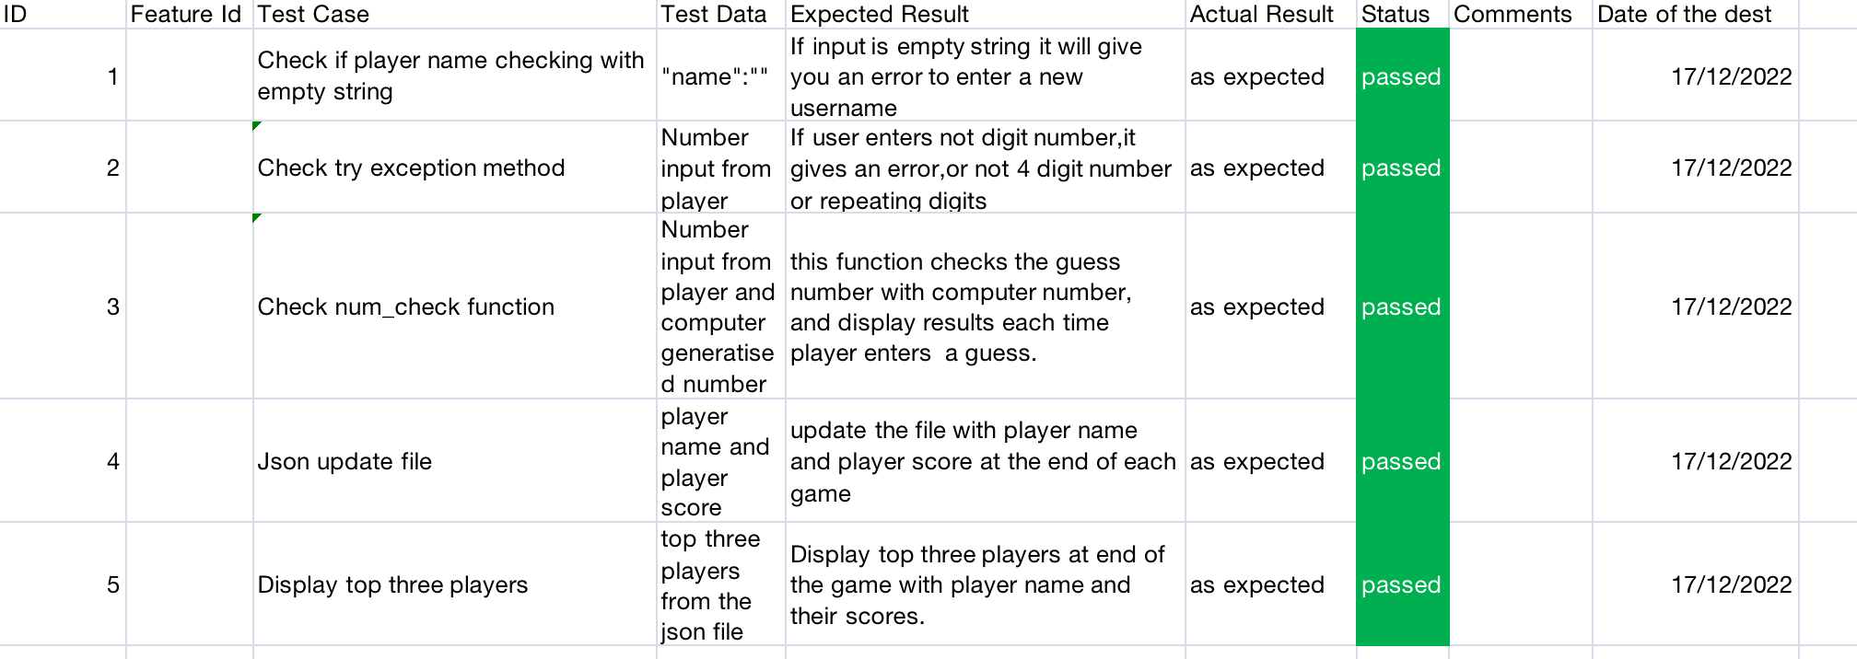
Testing ScreenShots

